Slide 1

VidyaNiketan College Of Engineering,Bota
BE- Computer Department 2022-23
Presentation On- Online Smart Business
Guided By- Prof. Dighe S.E.
Presented By-
Gaikwad Shradha
Wale Anuja
Sayyad Muskan

Slide 2
ONLINE SMART BUSINESS

Slide 3
AIM OF THE PROJECT
The project “SMART BUSINESS” is a small approach to automate the ledges of the retailers, distributors and stockiest and help them to overcome stress when comes to investment analysis and management of stocks, orders and maintaining products.
This project deals about the marketing and requirement strategy of the clients. These marketing strategies differ from
place to place, time to time and from product to product.
This is an application which is been developed and customized based on the categories of clients. The categories of
clients are i) Retailer ii) Distributor iii) Stockiest.
Using this application the retailer can maintain his/her profile. He/She can find all the distributors available for the
product for which has registered.
He/She can order the products from the nearest and available distributors based on the demands of the customers.
Similarly, using this application a distributor can maintain his/her profile and can find all the stockiest available for the products for which he/she has registered.
He/She can order the products from the nearest and available stockiest based on the demands of the retailers. They
can maintain the track of retailers existing in their location so that they can expand their business.

Slide 4
OBJECTIVE OF THIS PROJECT
Using this application the retailer can maintain his/her profile. He/She can find all the distributors available for the
product for which has registered.
He/She can order the products from the nearest and available distributors based on the demands of the customers.

Slide 5

SOFTWARE AND HARDWARE REQUIREMENTS
HARDWARE REQUIREMENTS:
Processor : Intel 3
Motherboard : Intel 915gvsr chipset board
Ram : 4 gb ddr2 ram
Hard disk drive : 160 gb
SOFTWARE REQUIREMENTS:
Front end : html5, css3, bootstrap
Back end : php, mysql
Control end : angular java script
PHP TOOLS:
xampp-win32-5.5.19-0-VC11
ANDROID TOOLS:
Android Emulator
xampp-win32-5.5.19-0-VC11
Android Studio

Slide 6
EXISTING SYSTEM
Its manual process for earlier system.
Its more time consume for all process.
Need for more resources.

Slide 7
DISADVANTAGES OF EXISTING SYSTEM
Some consumers value the personal touch they get from visiting a physical store and interacting with sales associates. Such personal touch is particularly important for businesses selling high-end products as customers not only want to buy the merchandise but also have a great experience during the process.
The biggest drawback of e-commerce is the issue of security. People fear to provide personal and financial information, even though several improvements have been made in relation to data encryption.
Many websites do not have high encryption for secure online transaction or to protect online identity. Some websites illegally collect statistics on consumers without their permission. Lack of privacy discourages people to use internet for conducting commercial transactions
People have to rely on electronic images to purchase products. Sometimes, when the products are delivered, the product may not match with electronic images. Finally, it may not suit the needs of the buyers. The lack of ‘touch and feel’ prevent people from online shopping.

Slide 8
PROPOSED SYSTEM
This system enhanced combined all stockiest, distributor, retailer and also user.
Its reduced time consuming process.
Here need limited resources only.

Slide 9
ADVANTAGES OF PROPOSED SYSTEM
Ecommerce allows you to reach customers all over the country and around the world. Your customers can make a purchase anywhere and anytime, especially more people are getting used to shopping on their mobile devices.
Ecommerce website through SEO, PPC ads or a good old postcard, there is a way to track your traffic and customers' entire user journey to get insights into keywords, user experience, marketing message, pricing strategy, and more.
Ecommerce platform technologies, it has become very easy and affordable to set up and maintain an
ecommerce store with a low overhead.
Ecommerce platforms give merchants the opportunity to serve up personalized content and product recommendations to registered customers. These targeted communications can help increase conversion by showing the most relevant content to each visitor.

Slide 10
MODULE LIST
ADMIN
Login
Approve User
STOCKIEST
Register
Login
Create Product
Name, price, description, offer, stock, specification, shipping days, charges
View My production
Upload image
Edit/Delete Product

Slide 11
MODULE LIST
DISTRIBUTOR
Register
Login
Create Product
Name, price, description, offer, stock, specification, shipping days, charges
View My production
Upload image
Edit/Delete Product
Get Order from Retailer
Update Delivery Status
RETAILER
Register
Login
View and search Products
Place Orders for Distributor
My order
View Delivery Status

Slide 12

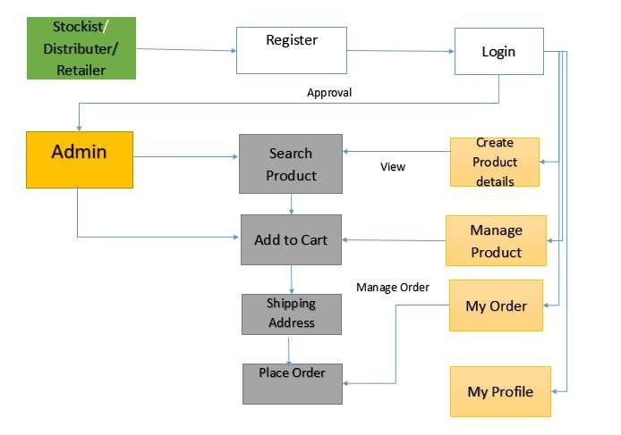
ARCHITECTURE DIAGRAMS
DIAGRAMS

Slide 13
USECASE DIAGRAMS
ADMIN
STOCKIEST
registration, login
create product
login
manage products
Administrator
approve user
stockiest
view my production
upload image
edit / delete product

Slide 14

USECASE DIAGRAMS
DISTRIBUTOR
login and register
create products
Manage products
view production
Distributor
upload Image
edit, delete product
get order from retailer
update delivery status

Slide 15
USECASE DIAGRAMS
RETALIER
registrator, login
view and search products
place orders for distributor
Retailer
my order
view delivery status

Slide 16
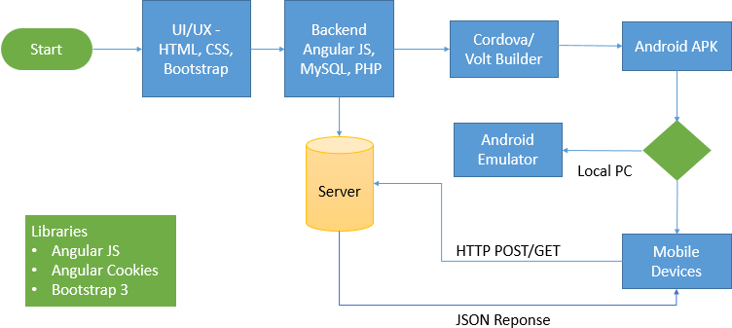
WORK FLOW DIAGRAM FOR ANDROID

Slide 17
CONCLUSION
The main objective of “ONLINE SMART BUSINESS” is to enhance and upgrade the existing system by
increasing it efficiency and effectiveness.
Due to the change in buying behavior of consumers, ecommerce business has emerged to provide another channel for shopping online. In an e-commerce business, orders are first received through the online platform, then the goods are delivered to customers.
Instead of visiting physical retail shops, the emergence of e-commerce provides convenience to customers. In this case, good logistics arrangements are crucial to ensure that the right goods can be delivered to customers in the right place and with good quality.
As cloud is adopted for E-commerce therefore proposed system is architected for resource provisioning which
achieves high availability and reliability. An innovative pricing policy is introduced for further cost reduction.

Slide 18
FUTURE ENHANCEMENT
In Future work, This application to develop a cross platforms like IOS & Widows.
In adding the more features of online smart business management system to develop access with user’s
flexibility.
To authenticate the users based on the system users list which is maintained by the operating system
To restrict the usage of all files by the users based on their privileges on the system

Slide 19
REFERNECES
[1] M. Falk, and E. Hagsten, “E-commerce trends and impacts across Europe”, International Journal of Production Economics, 170, pp. 357-369, 2015.
[2] J. Mosteller, N. Donthu, and S. Eroglu, “The fluent online shopping experience”, Journal of Business
Research, 67(11), pp. 2486-2493, 2014.
[3] Y. Fang, I. Qureshi, H. Sun, P. McCole, E. Ramsey, and K.H. Lim, “Trust, Satisfaction, and Online Repurchase Intention: The Moderating Role of Perceived Effectiveness of E-Commerce Institutional Mechanisms”. Management Information Systems Quarterly, 38(2), pp. 407-427, 2014.
[4] J. Lehtonen, J. M.Småros, P. Appelqvist, and J. Holmström, “The impact of increasing demand visibility on production and inventory control efficiency”, International Journal of Physical Distribution & Logistics Management, 33(4), pp. 336-354, 2003.
[5] R. Ramanathan, U. Ramanathan, and H. Hsiao, “The impact of ecommerce on Taiwanese SMEs: Marketing
and operations effects”, International Journal of Production Economics, 140(2), pp. 934-943, 2012.

Slide 20
THANK - YOU

